Slide 1
CSE225: Data Structure and Algorithm Array & Searching

Slide 2
Array
Declaration
Initialization
Accessing Array Elements
Inserting and Deleting in a Unsorted Array
Inserting and Deleting in a Sorted Array

Slide 3
Linear Arrays
A linear array is a list of a finite number of n homogeneous data elements (that is data elements of the same type) such that.
The elements are of the arrays are referenced respectively by an index set consisting of n consecutive numbers.
The elements of the arrays are stored respectively in successive memory locations.

Slide 4
Linear Arrays
The number n of elements is called the length or size of the array.
The index set consists of the integer 0,1, 2, …n-1
Length or the number of data elements of the array can be obtained from the index set by
Length = UB – LB + 1
where
UB is the largest index called the upper bound and
LB is the smallest index called the lower bound of the arrays

Slide 5
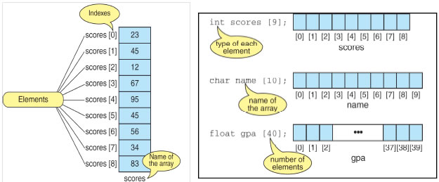
Linear Arrays
Element of an array A may be denoted by
Subscript notation A₁, A₂, , …. , A_{n}
Parenthesis notation A(1), A(2), …. , A(n)
Bracket notation A[1], A[2], ….. , A[n]
The number K in A[K] is called subscript or an index and A[K] is called a subscripted variable.

Slide 6
Declaring and Initializing Arrays
To declare an array:
data_type array_name[SIZE];
int ar_name[10]
data_type is a valid data type that must be common to all elements.
array_name is name given to array
SIZE is a constant value that defines array maximum capacity.
Initializing Arrays
Initialization of an array either one by one or using a single statement as follows −
int ar[5];
ar[0]=10; ar[1]=20;
double balance[5] = {1000.0, 2.0, 3.4, 7.0, 50.0};

Slide 7
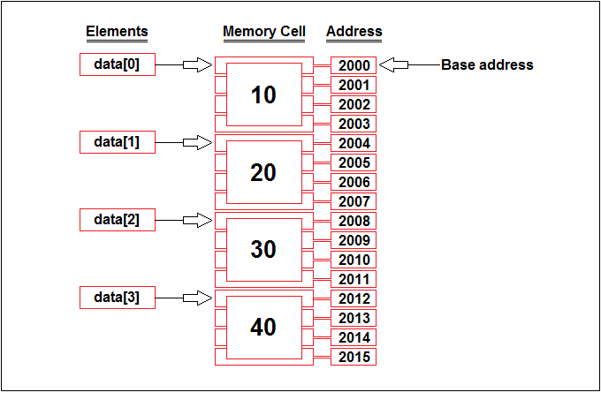
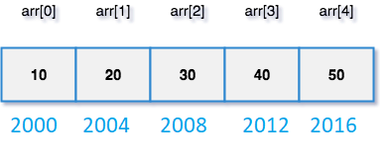
Representation of Linear Array in Memory

Slide 8
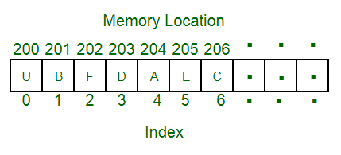
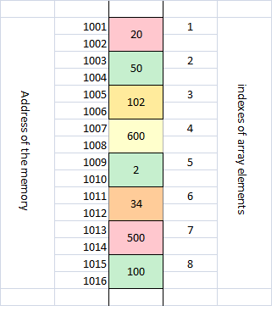
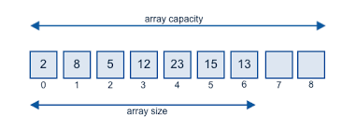
Representation of Linear Array in Memory

Slide 9
Representation of Linear Array in Memory
int LA[10]
Let
LA be a linear array in the memory of the computer.
LOC(LA[K]) = address of the element LA[K]
Computer does not keep track of the address of every element of the array
Keep track address of the first element of array called the base address of LA and denoted by Base(LA)
LOC(LA[K]) = Base(LA) + w(K– lower bound)
where w is the number of words per memory cell

Slide 10
Example 1
Find the address for LA[6] Each element of the array occupy 1 byte
200
201
202
203
204
205
206
207
LA[1]
LA[2]
LA[3]
LA[4]
LA[5]
LA[6]
LA[7]
LA[8]
LOC(LA[K]) = Base(LA) + w(K – lower bound) :
LOC(LA[6]) = 200 + 1(6 – 1) = 205

Slide 11
Example 2
Find the address for LA[16] Each element of the array occupy 2 byte
200
201
202
203
204
205
206
207
LA[0]
LA[1]
LA[2]
LA[3]
LOC(LA[K]) = Base(LA) + w(K – lower bound) :
LOC(LA[16]) = 200 + 2(16 – 0) = 232

Slide 12
Searching Arrays
Linear search: Compare each element of array with key value
Search an array for a key value
Simple
Useful for small and unsorted arrays
Suppose you want to find a number in an unordered sequence
You have no choice – look through all elements until you have found a match
This is called linear or sequential search

Slide 13
Linear Search(LA,N, ITEM)
Linear Search (LA, N, ITEM) Here LA is a linear array with N elements. This algorithm find an element ITEM into the LA.
i=0
Repeat steps 3 and 4 while i>=n or LA[i]==ITEM
IF LA[i]==ITEM print item found at index i and exit
i=i+1
Print item not found and exit.
int search(int data[],int n, int item)
{
for(int i = 0; i<n; i++)
{
if(data[i] == item)
return i;
}
return -1;
}

Slide 14
Searching Arrays: Binary Search
Binary search
For sorted arrays
Compares middle element with key
If equal, match found
If key < middle, looks in first half of array
If key > middle, looks in last half
Repeat
Very fast; at most n steps, where 2^{n} > number of elements
30 element array takes at most 5 steps
2⁵ > 30 so at most 5 steps

Slide 15
Searching Arrays: Binary Search
int bsearch(int data[], int n, int value )
{
int first, middle, last;
first = 0;
last = n - 1;
while (true) {
middle = (first + last) / 2;
if (data[middle] == value)
return middle;
else if (first >= last)
return -1;
else if (value < data[middle])
last = middle - 1;
else
first = middle + 1;
}
}

Slide 16
Inserting in Unsorted Array
INSERT (LA, N, ITEM) Here LA is a linear array with N elements. This algorithm inserts an element ITEM into the LA.
If MAX==N, print overflow
Set LA[N] :=ITEM
[Reset N.] Set N := N + 1.
Exit.

Slide 17
Delete in Unsorted Array
DELETE (LA, N, k) Here LA is a linear array with N elements. This algorithm Delete the element ITEM from the LA.
Set LA[k] :=LA[N-1]
[Reset N.] Set N := N - 1.
Exit.

Slide 18
INSERT_SORTL (LA, N, K, ITEM)
Here LA is a sorted array with N elements and K is a positive integer such that K<N. This algorithm insert an element ITEM from the Kth position in LA.
1. j=N
2. Repeat step while LA[j]>ITEM;
3. Set LA[j]=LA[j-1]
4. Set LA[j]=ITEM
5. [Reset N.] Set N := N+1;
6. Exit.
0 | 10
1 | 20
2 | 25
3 | 30
4 | 40
5 | 45
6 | 50
7 | 60
8 | 70
9 | 80

Slide 19
DELETE_SORTL (LA, N, K, ITEM)
Here LA is a sorted array with N elements and K is a positive integer such that K<N. This algorithm Delete an element ITEM from the Kth position in LA.
SEARCH(LA, N, K, ITEM)
/* Find the item and return k as item’s index
Set j : = k.
2. Repeat Steps 3 and 4 while .j <= n.
3. Move j^{th} element upward.
Set LA[j ] := LA[j+1].
4. [Decrease counter.] Set j:= j+1. [End of Step 2 loop.]
5. [Reset N.] Set N := N-1;
6. Exit.
0 | 10
1 | 20
2 | 30
3 | 50
4 | 60
5 | 70
6 | 80
7 | 80

Slide 20
Multidimensional Array
One-Dimensional Array
Two-Dimensional Array
Three-Dimensional Array
Some programming Language allows as many as 7 dimension

Slide 21
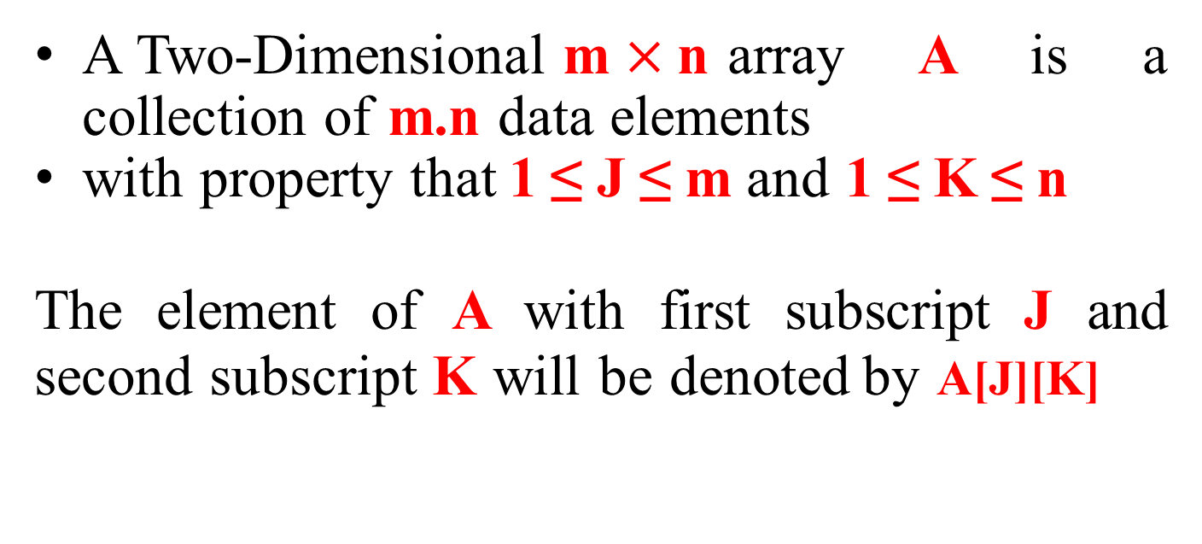
Two-Dimensional Array
A Two-Dimensional m $×$n array A is a collection of m.n data elements
with property that 1 ≤ J ≤ m and 1 ≤ K ≤ n
The element of A with first subscript J and second subscript K will be denoted by A[J][K]

Slide 22
2D Arrays
The elements of a 2-dimensional array a is shown as below
a[0][0]
a[1][0]
a[2][0]
a[0][1]
a[1][1]
a[2][1]
a[0][2]
a[1][2]
a[2][2]
a[0][3]
a[1][3]
a[2][3]

Slide 23
Rows Of A 2D Array
a[0][0]
a[1][0]
a[2][0]
a[0][1]
a[1][1]
a[2][1]
a[0][2]
a[1][2]
a[2][2]
a[0][3]
a[1][3]
a[2][3]
row 0
row 1
row 2

Slide 24
Columns Of A 2D Array
a[0][0]
a[1][0]
a[2][0]
a[0][1]
a[1][1]
a[2][1]
a[0][2]
a[1][2]
a[2][2]
a[0][3]
a[1][3]
a[2][3]
column 0
column 1
_{column 2} column 3

Slide 25
2D Array
Let A be a two-dimensional array m x n
The array A will be represented in the memory by a block of m x n sequential memory location
Programming language will store array A either
Column by Column
(Called Column-Major Order) Ex: Fortran, MATLAB
Row by Row
(Called Row-Major Order) Ex: C, C++ , Java

Slide 26
2D Array in Memory
A Subscript
 | (1,1)
 | ^{(2,1)} Column
 | (3,1)
 | (1,2)
 | (2,2) _{Colum}
 | (3,2)
 | (1,3)
 | (2,3) Colu
 | (3,3)
 | (1,4)
 | _{(2,4)} Colum
 | (3,4)
A | Subscript
 | (1,1)
 | (1,2) | Row 1
 | (1,3)
 | (1,4)
 | (2,1)
 | (2,2)
 | (2,3) | Row2
 | (2,4)
 | (3,1)
 | (3,2) | Row3
 | (3,3)
 | (3,4)
1
n 2
mn 3
n 4
Column-Major Order
Row-Major Order

